Slide 1
Designing a high affinity ligand for the A₁ Adenosine Receptor
Zeynep Tufan, Lili Hu & Katie Lynch
Notes:
Good morning everyone, today Zeynep, Lili and I will be presenting our work on designing a high affinity ligand for the A1 Adenosine receptor.

Slide 2
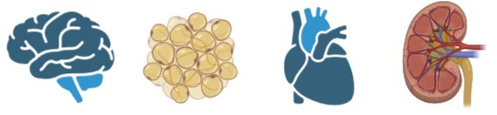
Adenosine Receptors (ARs)
A₁
A_{2A}
A_{2B}
A₃
A₁AR Activation¹:
↓ Heart rate & atrial contractility
Anti-nociception
Control of lipolysis
A₁AR Inhibition¹:
Enhanced cognition
Diuretic effects
Inhibition of seizure activity
ischemic heart disease, anxiety, dementia, epilepsy, renal failure, diabetes
1. Jacobson, K. A., & Gao, Z. G. (2006). Adenosine receptors as therapeutic targets. In Nature Reviews Drug Discovery (Vol. 5, Issue 3, pp. 247–264). https://doi.org/10.1038/nrd1983
Notes:
Adenosine receptors, which are involved in a wide range of physiological processes, are part of the G-protein coupled receptor (GPCR) family. There are 4 known adenosine receptors subtypes, namely: A1, A2A, A2B and A3. However, in this instance we are really only concerned with the A1 adenosine receptor.
This receptor is widely distributed throughout the body but is predominantly located in the brain, adipose tissue, heart and kidneys.
The A1A receptor also has a wide range of functions. Activation of the receptor can cause a decrease in heart rate and atrial contractility, induce antinociception and control lipolysis
Meanwhile, inhibition of the receptor can lead to enhanced cognition, diuretic effects and the inhibition of seizure activity.
For these reasons, targeting the A₁ adenosine receptor has been considered for treating ischemic heart disease, anxiety, dementia, epilepsy, renal failure, diabetes and more.
(Jacobson & Gao, 2006)

Slide 3
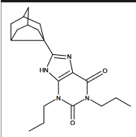
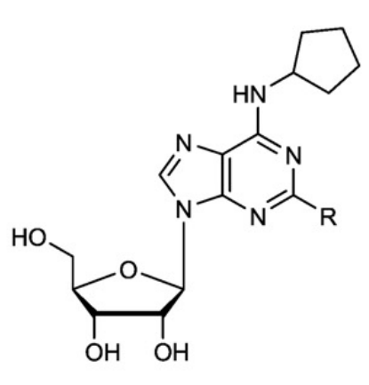
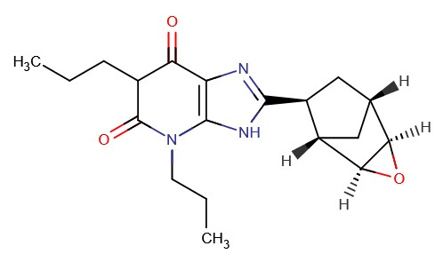
A₁AR Ligands
There are very few A₁AR drug candidates that have successfully progressed through clinical trials²
https://doi.org/10.1016/j.bbamem.2010.12.017
image: https://go.drugbank.com/structures/DB06471/image.svg
https://doi.org/10.2217/14796678.4.2.117
N6-cyclopentyl-adenosine (CPA)
Naxifylline
Rolofylline
2. Glukhova, A., Thal, D. M., Nguyen, A. T., Vecchio, E. A., Jörg, M., Scammells, P. J., May, L. T., Sexton, P. M., & Christopoulos, A. (2017). Structure of the Adenosine A1 Receptor Reveals the Basis for Subtype Selectivity. Cell, 168(5), 867-877.e13. https://doi.org/10.1016/j.cell.2017.01.042
Notes:
Despite the A₁AR playing a pivotal role in cardiac, renal and neuronal processes, it remains poorly targeted by drugs.
There are very few A₁AR drugs that have successfully progressed through clinical trials and there are currently NO A₁AR drugs actually on the market.
The downfall of A₁AR drugs is often because the widespread distribution of the receptor can cause a lot of off-target effects.
Having said this I will still mention a couple of the ligands that have been developed but are not currently on the market.
N6-cyclopentyl-adenosine (CPA) A₁AR agonist which is an effective antinociceptive agent.
Naxifylline is an AA1R antagonist used in the treatment of congestive heart failure (image: https://go.drugbank.com/structures/DB06471/image.svg).
And, rolofylline is an experimental diuretic which acts as a selective adenosine A1 receptor antagonist. (Glukhova et al., 2017 and Chaparro et al., 2008)
The A1-AR remains a highly pursued therapeutic target (Fredholm et al., 2011; Jacobson and Gao, 2006), yet there are no selective, clinically approved, A1-AR agonists or antagonists currently available.
Because none of these compounds are clinically approved, they do not have (anatomical therapeutic chemical (ATC) codes

Slide 4
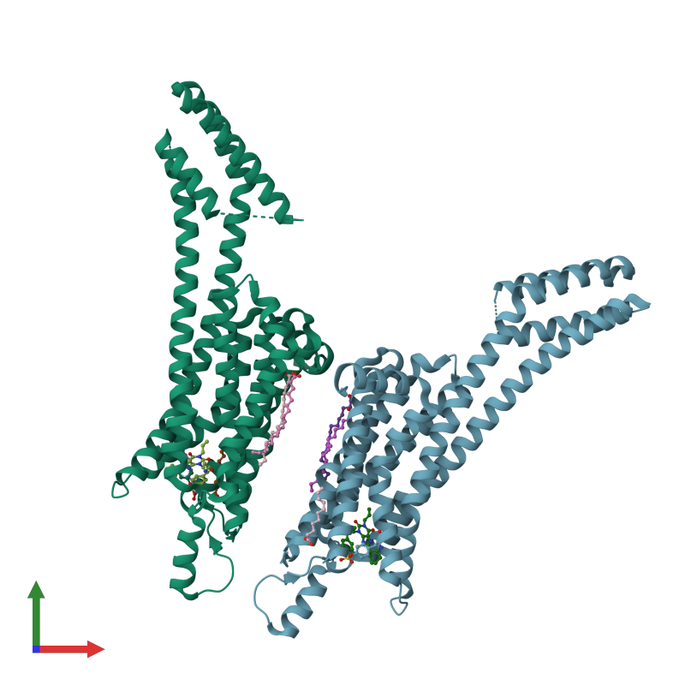
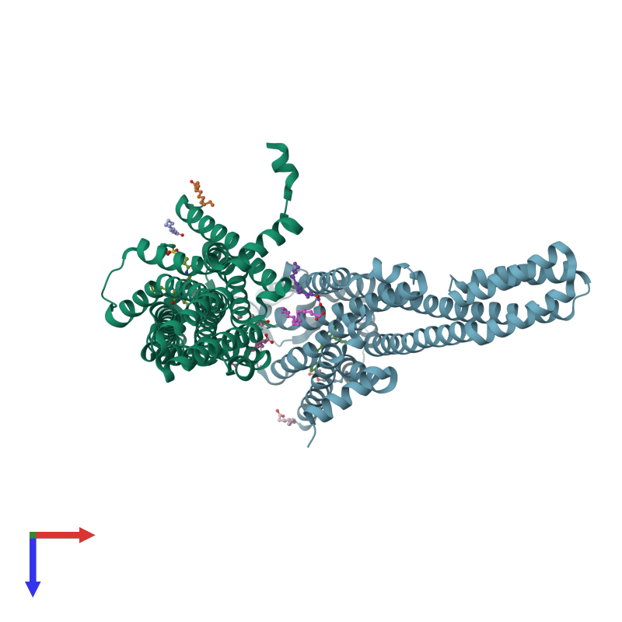
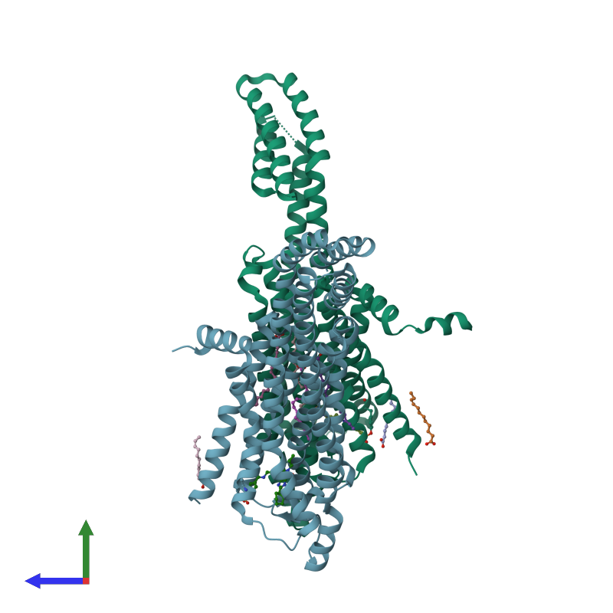
The A₁AR Structure
Top View
Front View
G_{i/o} coupled³
Length: 326 amino acids
Mass: 36.5 kDa
Side View
https://www.ebi.ac.uk/pdbe/entry/pdb/5uen
3. Müller, C. E., & Jacobson, K. A. (2011). Recent developments in adenosine receptor ligands and their potential as novel drugs. In Biochimica et Biophysica Acta - Biomembranes (Vol. 1808, Issue 5, pp. 1290–1308). https://doi.org/10.1016/j.bbamem.2010.12.017
Notes:
Shown here are two copies of the human A1 adenosine receptor in a non-crystallographic formation.
As mentioned previously , the adenosine A1 receptor is a g-protein coupled receptor, and consists of a single polypeptide chain that transverses the membrane from the extracellular side beginning at the N terminus to form seven transmembrane helices.
The A1 receptor is preferentially Gi/o coupled to inhibit adenylate cyclase and consequently the production of cyclic AMP (https://doi.org/10.1016/j.bbamem.2010.12.017).
The structure is 326 amino acids in length and has an approximate mass of 36.5 kilo daltons. https://www.ebi.ac.uk/pdbe/entry/pdb/5uen

Slide 5
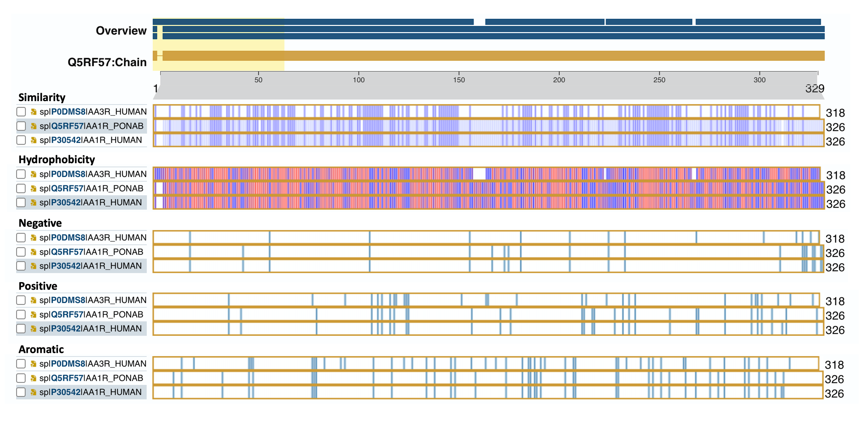
Comparison of A₁AR with similar proteins
47.8%
99.1%
Notes:
In this slide you can see the comparison of our target – the A₁ adenosine receptor, with a similar non-human protein, in this case the A₁ Adenosine receptor of the Sumatran orangutan, and the human A₃ adenosine receptor.
In these images, the blue lines indicate a match in amino acids between the different proteins. It is clear by the fact that there are more matches in the human and non-human A₁ARs that our target is more similar to the non-human A1AR receptor compared with the human A3 Adenosine receptor.
The similarity between the two A1 AR receptors was 99.1% while the similarity between the human A1 and A3 adenosine receptors was 47.8%

Slide 6
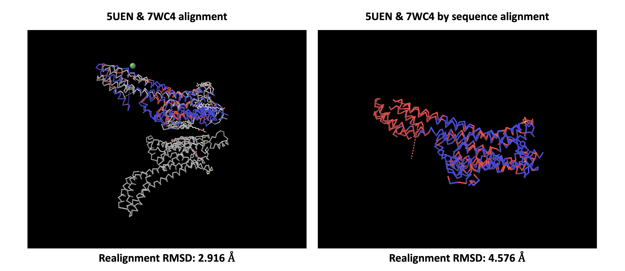
7WC4: Similar protein based on structure
Notes:
We also performed a search for proteins that have a similar 3D structure to the human A1 receptor (PBD code: 5UEN) and found that 7WC4 is very similar.
From the first image we see the two structures superposed onto each other. The blue regions indicate where the amino acid sequences of the proteins match, and the red shows where they are different. The grey parts are showing where the molecules are not at all aligned.
In the second image, we are only looking at the regions of the proteins that have the same sequence alignment. Again the red regions are where the amino acid sequences of the two proteins are differen and the blue regions show the areas with the same amino acid sequence.

Slide 7
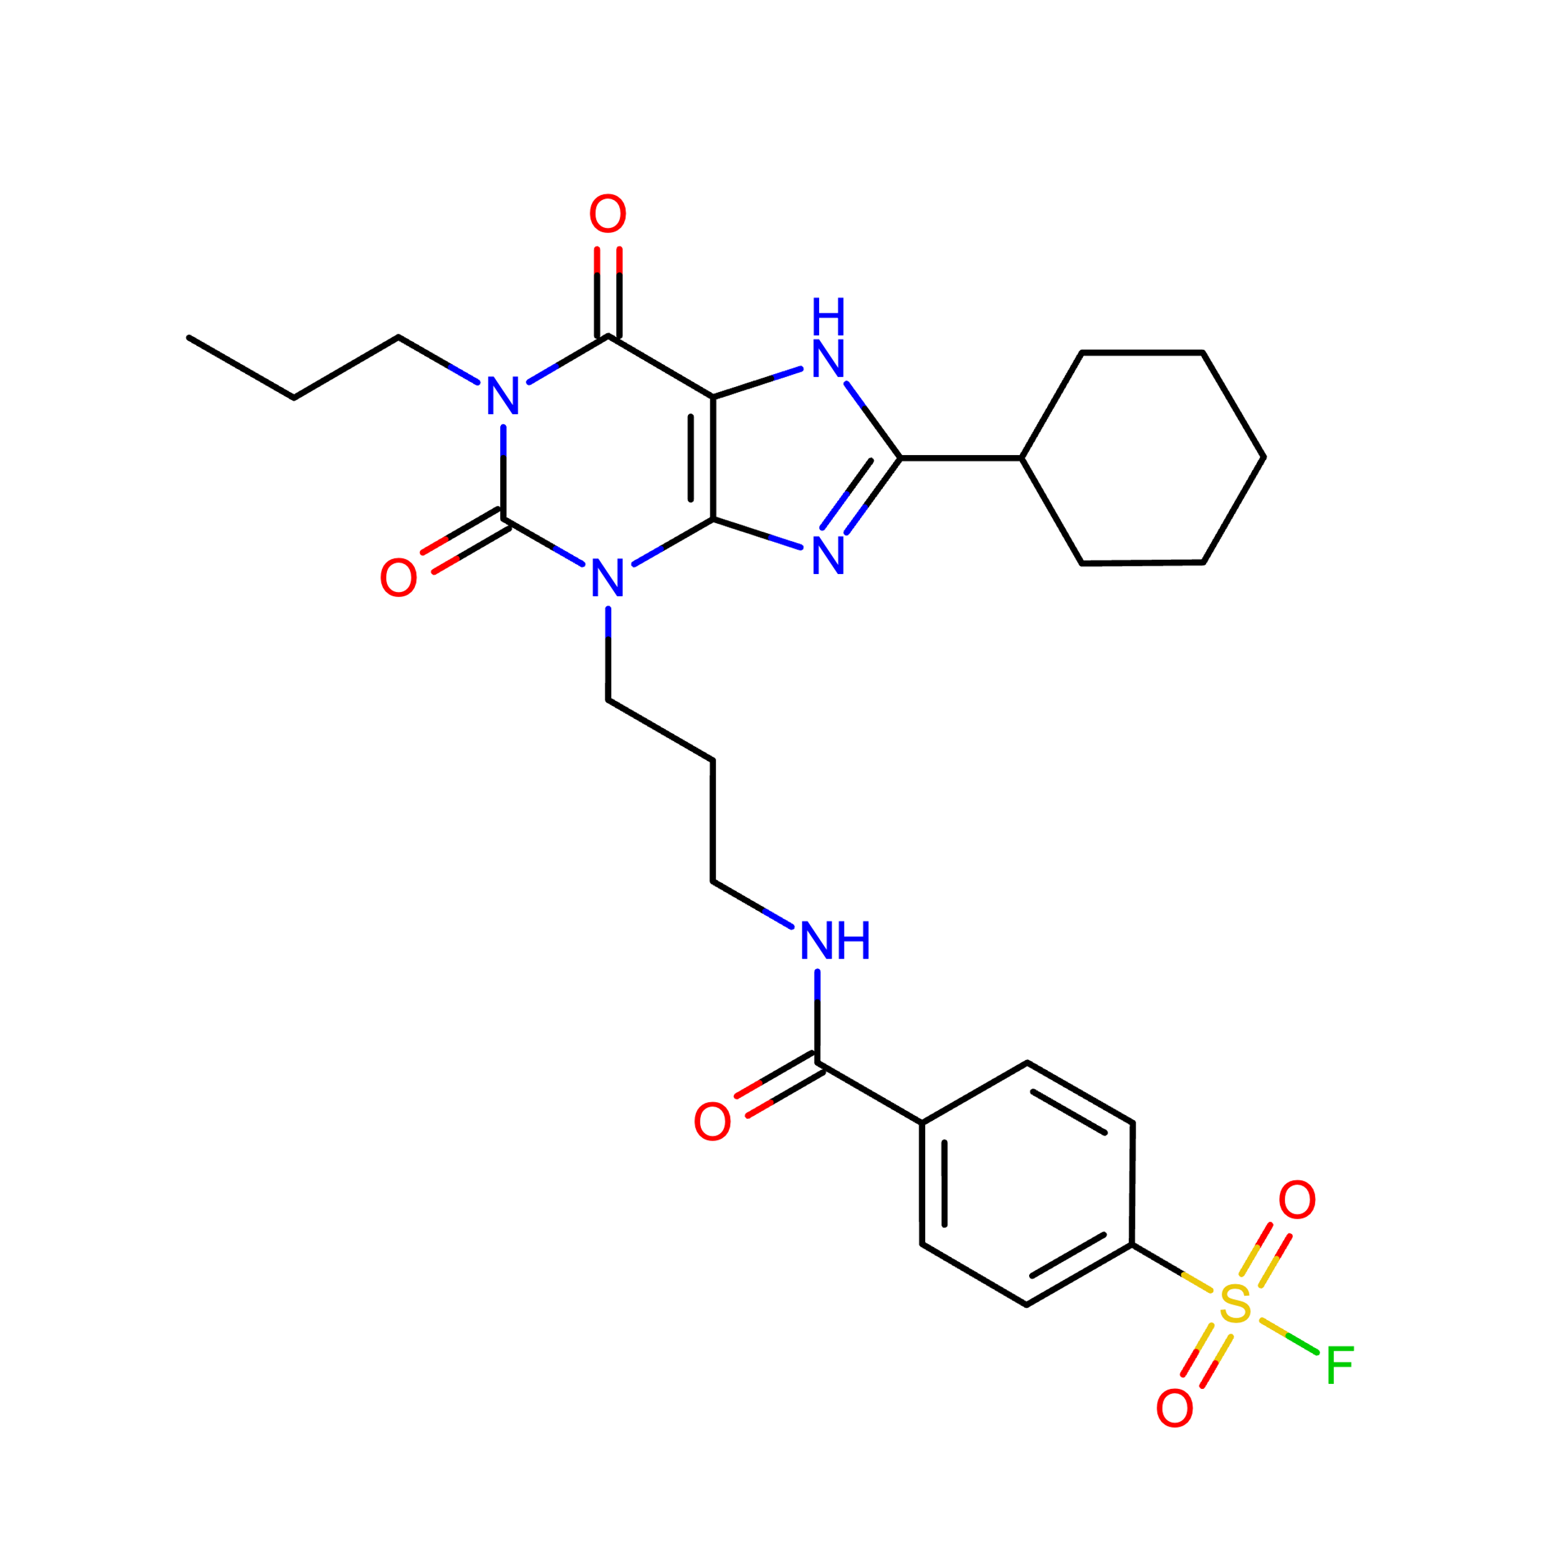
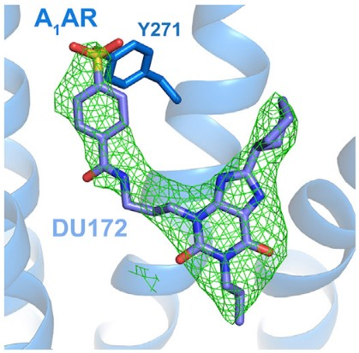
A₁AR Ligand: DU172
Https://www.rcsb.org/structure/5uen
https://doi.org/10.1016/j.cell.2017.01.042
Notes:
This brings us to the main point of our project – to design a novel ligand with high affinity for the A₁ adenosine receptor.
To do this, we first need to look at an existing ligand with high affinity for our target – DU172.
This ligand was recently found to have a very high affinity for the human A₁ AR receptor (PBD code: 5UEN). DU172 is an A1 adenosine receptor antagonist that co-crystallizes with the receptor at a resolution of 3.2A.

Slide 8
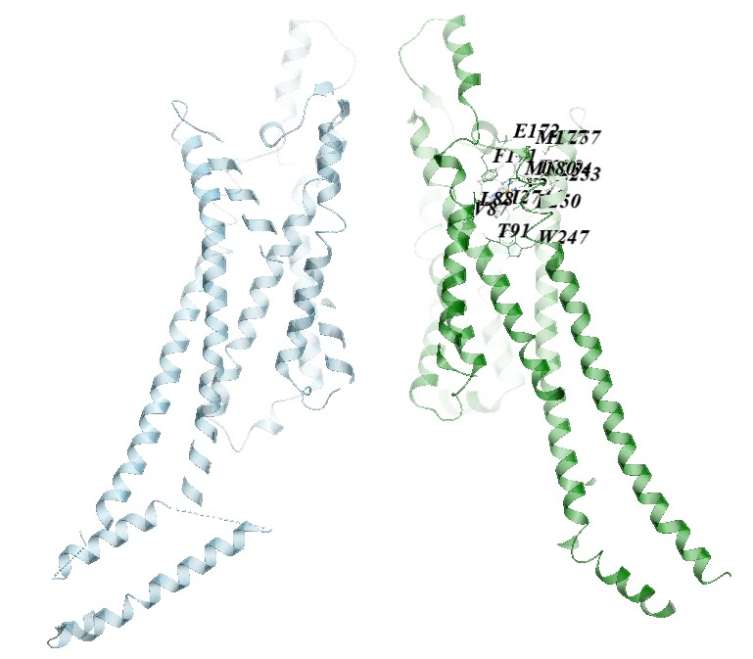
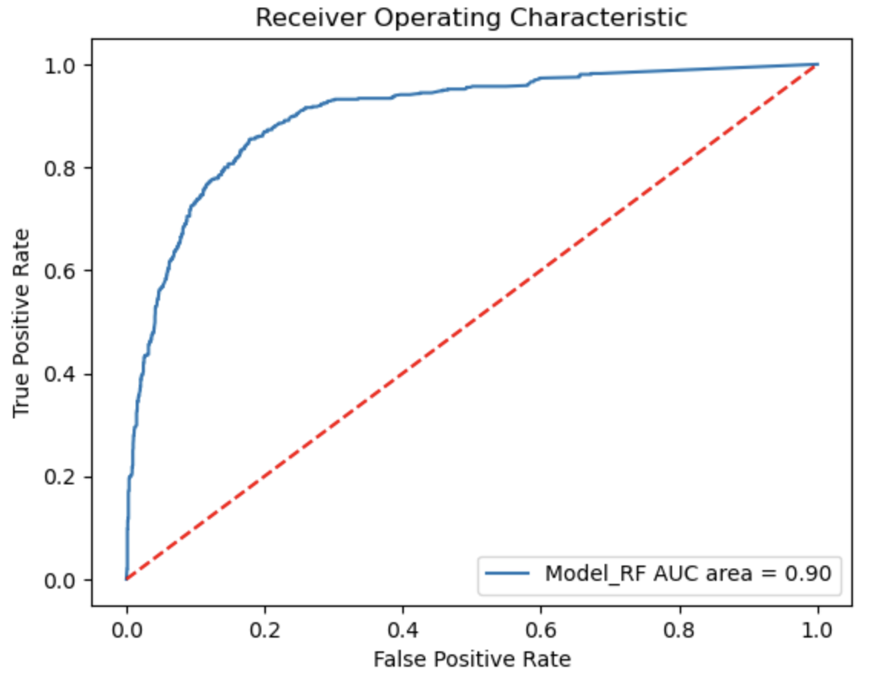
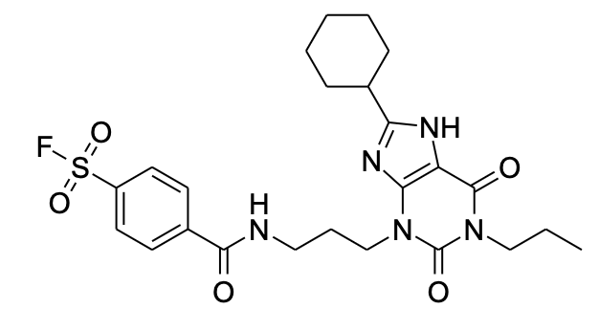
Predicting DU1 affinity to A₁AR
Aim: Predict affinity score using machine learning and molecular docking.
Target: A₁AR (CHEMBL226)
Ligand: DU1 (CHEMBL144360)
➔ Redocking DU-1 by ICM-Pro
 | SMILES | pChembl (ML) | pChembl (dock) | Average score | Affinity by ICM-pro
Ligand_00 | CCCN1C(=O)C2=C(N=C(N2)C3CCCCC3)N(C1=O)CCCNC(=O)C4=CC=C(C=C4)S(=O)(=O)F | 7.34 | 6.71 | 7.02 | -28.15

Slide 9
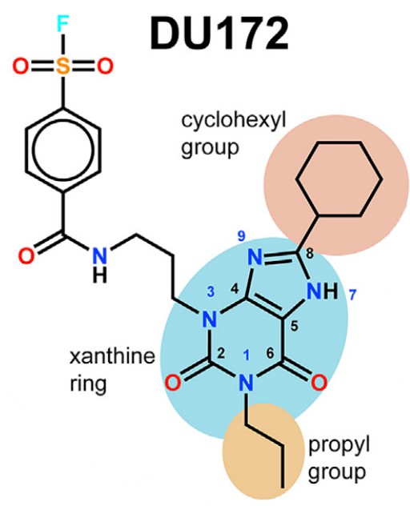
Designing a Ligand with high affinity for A₁AR
The backbone of selectivity for the A₁AR²
2. Glukhova, A., Thal, D. M., Nguyen, A. T., Vecchio, E. A., Jörg, M., Scammells, P. J., May, L. T., Sexton, P. M., & Christopoulos, A. (2017). Structure of the Adenosine A1 Receptor Reveals the Basis for Subtype Selectivity. Cell, 168(5), 867-877.e13. https://doi.org/10.1016/j.cell.2017.01.042
Notes:
N⁶ cycloalkyl substitution has been the most successful and general means of achieving selectivity for the A₁AR (Müller & Jacobson, 2011).
Most of the useful analogues are modified in the N6- or 2-position of the adenine moiety and in the 3′-, 4′- or 5′-position of the ribose moiety (Jacobson &Gao, 2006).

Slide 10
Predicting the affinity to A₁AR
Design new ligands using DU1-scaffold
Predict affinity to A₁AR using machine learning
If pChembl > 8.00 ➔ molecular docking
Predict affinity to A₁AR using AutoDock Vina
Average
70 ligands
15 ligands
 | SMILES | pChembl (ML) | pChembl (dock) | Average score
00 | CCCN1C(=O)C2=C(N=C(N2)C3CCCCC3)N(C1=O)CCCNC(=O)C4=CC=C(C=C4)S(=O)(=O)F | 7.34 | 6.71 | 7.02
59 | CCCN1C(C2=C(N(C/C=C/NC(C3CCCCC3)=O)C1=O)N=C(C4CCCC4)N2)=O | 8.38 | 6.94 | 7.66
65 | CCCN1C(C2=C(N(C(O)/C=C/NC(C3=CC=C(S(=O)(F)=O)C=C3)=O)C1=O)N=C(C4CCCC4)N2)=O | 8.11 | 7.09 | 7.60
63 | CCCN1C(C2=C(N(C/C=C/NC(C3=CC=C(S(=O)(F)=O)C=C3)=O)C1=O)N=C(C4CCCC4)N2)=O | 8.39 | 6.66 | 7.53

Slide 11
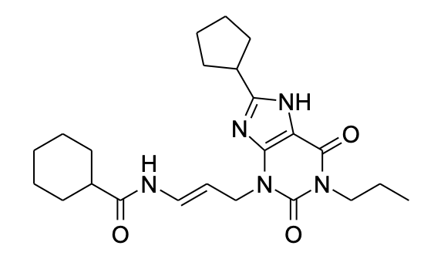
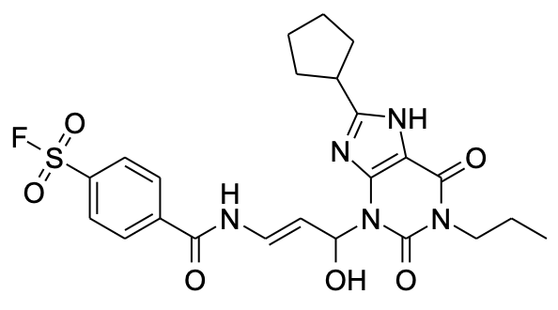
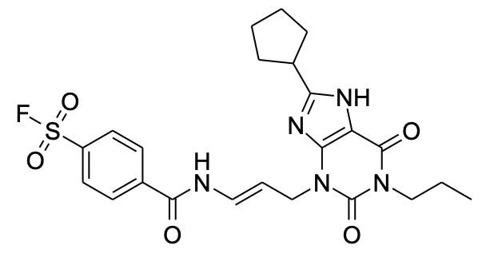
Overview A₁AR ligands
Most important modifications
Ligand_00 (DU1) | Ligand_59 | Ligand_65 | Ligand_63
7.02 | 7.66 | 7.60 | 7.53

Slide 12
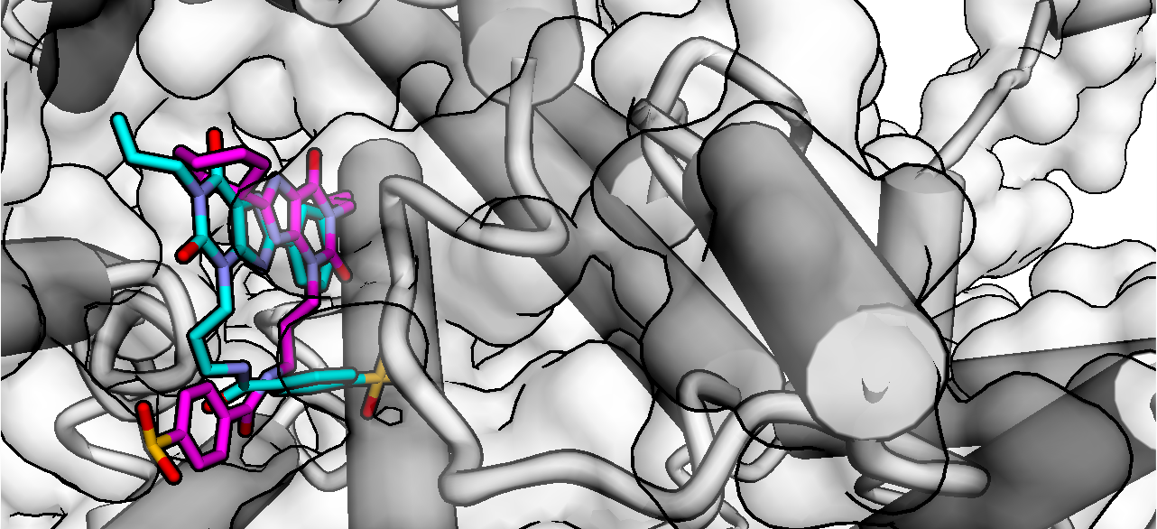
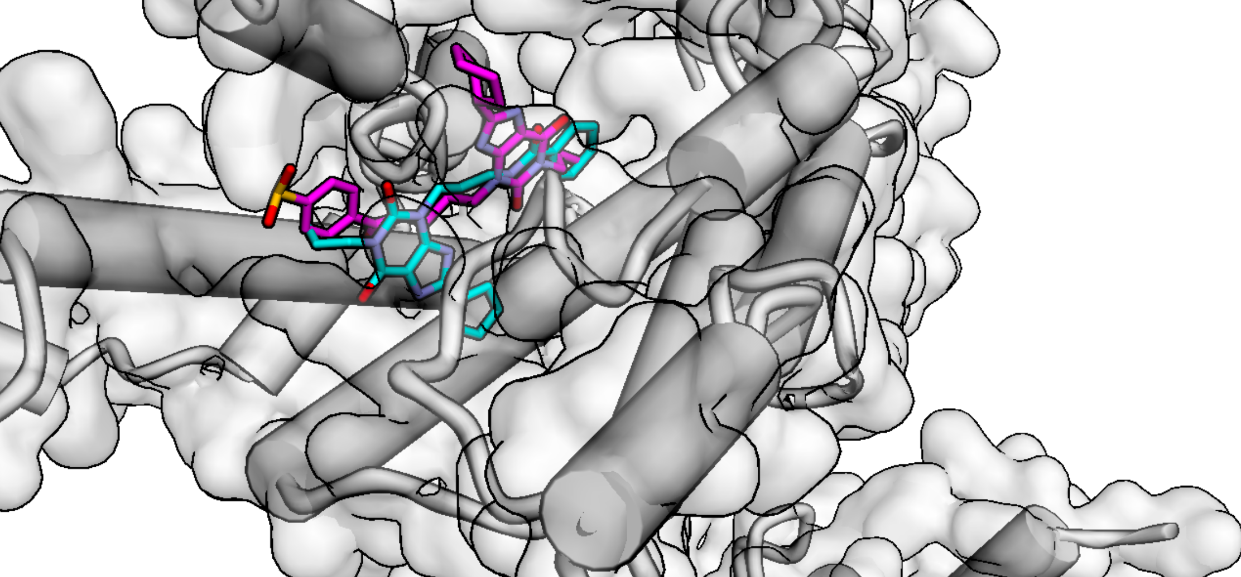
Docking positions of DU1 and ligand_59
DU1 (Ligand_00)
Ligand_59

Slide 13
Summary
DU1 was redocked in different docking software + machine learning
A novel ligand with higher affinity for A₁AR was docked
DU1
Ligand_59

Slide 14
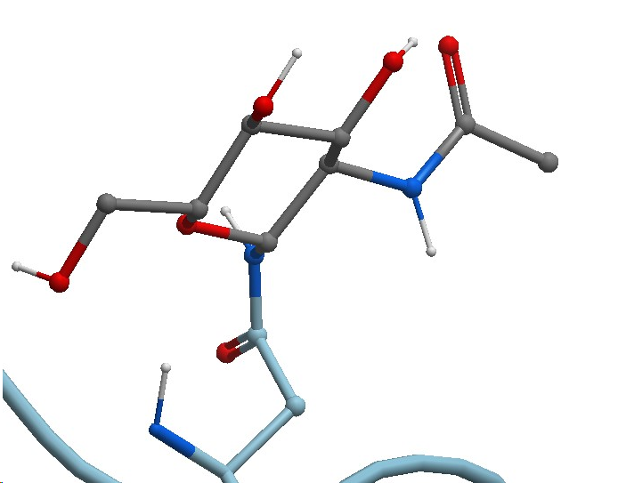
Discussion and Future Perspectives
Difference in docking scores
Validation of docking scores is needed
Three N-glycosylation sites
Docking on the glycosylated A₁ AR

Slide 15
Thank you for listening, questions?

